Slide 1

APR Prep Session:
Crisis Communication &
Media Relations
Gina Luttrell, Ph.D.
(There is no audio in this presentation)
Gina Luttrell, Ph.D. Assistant Professor of Public Relations & Social Media, Syracuse University
Twitter: @ginaluttrell

Slide 2
Conditions of Crisis
Surprise
  Unanticipated?
  High Uncertainty / Lack of Information
  Outside Normal Comfort Zone
Perceived Threat
  High Priority Goal (Reputation)
  Probability of Loss x Value of Loss
Short Response Time
  Slow Response, Increased Harm
  Inadequate information for a response
Notes:
The objectives of crisis communication planning include the following:
To understand the types of situations that could create a crisis for your organization.
To know what strategies can help navigate your client through a crisis.
To be aware of how crises affect publics and how to be sensitive to their needs throughout a crisis.
There are three main categories –
I’ve included surprise at the top of the list, but in reality all crisis have what we call “prodromes.” These are indicators that something is about to occur. Take the most recent BP, Gulf Oil spill. Weeks prior to the major disaster there was a valve that malfunctioned. The oil crews knew the possibility of a spill, yet failed to act. This is a prodrome.
Perceived threats – can someone or something harm your reputation? In this instance we would need to calculate the probability of a loss by the value of a loss.
In a media driven world time is everything. Response to crisis need to happen quickly. If a crisis breaks on twitter brands have a matter of hours, not days.

Slide 3
Causes and Types
Crises can be caused by scandals (Paula Deen, Penn State) or by natural things (hurricanes, tsunamis, ebola, …etc.)
Two factors are always present:
  they involve people and
  they interrupt the normal routine.
They can be physically violent (terrorist attack) or nonviolent (companies cutting their pensions to ward off bankruptcy).
They can be intentional - layoffs
They can be unintentional - tsunami
Notes:
Crisis management can be defined as the process by which an organization deals with a major unpredictable event that threatens to harm the organization, its stakeholders, or the general public
A variety of crisis can happen.
Natural Crisis. Disturbances in the environment and nature lead to natural crisis.
Technological Crisis.
Confrontation Crisis.
Crisis of Malevolence.
Crisis of Organizational Misdeeds.
Crisis due to Workplace Violence.
Crisis Due to Rumors.
Bankruptcy.
Regardless of the medium, crisis interfere with normal business routines.
Technological crises
caused by human application of science and technology
when technology becomes complex and coupled and something goes wrong in the system as a whole (Technological breakdowns)
Crises of organizational misdeeds
- when management takes actions it knows will harm or place stakeholders at risk for harm without adequate precautions

Slide 4
Crisis Stages –Preparation
Analyze your organization - You must try to decide which issues are likely to contain events that will trigger a crisis.
Assess the risks –
  Prodromes: List the kinds of crises your organization is most likely to face and prepare for the worst.
  Recognize the difference between bad publicity and a true crisis and respond accordingly.
Put together your Crisis Team
  Develop your strategy
  Develop your plan
  Rehearse your plan
Clarify communication activities / responsibilities.
Who does what, when, and reports back?
Notes:
Before a crisis becomes a crisis, it’s a problem and company leaders should never ignore a problem -- no matter how big or small. So never ignore the agitators -- the people that attend every council meeting or the Friends of … on Facebook, posting negative comments.
The complainers and what they post are your early warning system.
This includes knowing who the stakeholders are, where they are discussing the issue and what they and others are saying about it. While developing your communication plan, meet with other parts of your emergency response team in the organization and appeal for their help—get agreements on paper

Slide 5
Five Stages of a Crisis
1. Pre –Crisis: Before event erupts
  Prepare in Advance
2. Initial Event: Trigger event
  Isolate the Origin
3. Maintenance: Initial intensity has dissipated
  Evaluate the Impact
4. Resolution: Crisis is contained/No new harm
  Mitigate the Crisis
5. Evaluation: Assessment/ Learning/ Critique/New Normal
  Learn from the Crisis
Notes:
These are the five stages of crisis planning.
In the precrisis phase (don’t wait for an event to make your case):
Explain the benefits and risks of not including communicators.
Show your expertise by training leadership.
Do community relations so partners and stakeholders have an expectation of your involvement.
Planning starts before a crisis ever breaks. Most companies fail in the pre-planning phase. This causes crisis to linger.
When Training Leadership About Communication
Teach the organizational focus
Teach the mistakes of past events
Teach emergency risk principles
The credibility and reputation of organizations is heavily influenced by the perception of their responses during crisis situations.

Slide 6
Dealing with a Crisis
Your objective is to maintain corporate credibility, even if the organization is at fault and attend to the smallest detail to maintain trust.
Crisis plan itself should be a guideline vs. detailed for ease of recall and flexibility.
Communication intersects with all stages of crisis (including before and during).
Notes:
When a problem becomes a crises … Respond don’t react
-- address the issues dead on.
-- be visible and accessible
-- don’t blame / fix the problem.
Think about the Flint Water Crisis. The Republican governor failed in include the Democrat mayor in a number of press conferences about the crisis in Flint including when he released a 75 point plan to address the issues – it would have been an easier sell if the Mayor was aware of it. As I am sure there were also times that the Mayor did not include the Governor.
Focus on people, the community, consumers, and address the short and long term needs of the community -- immediately.
Immediately grasp the emotions involved in the issue and go support the people affected.
Gather the facts quickly, tell the media what you know
Accountability -- Question the data - Seek a second opinion if you have to, especially if independent data from another trusted source is telling a different story
Crisis management consists of:
Methods used to respond to both the reality and perception of crises
Establishing metrics to define what scenarios constitute a crisis and should consequently trigger the necessary response mechanisms.
Communication that occurs within the response phase of emergency management scenarios

Slide 7
Five Communication Constants
During a Crisis
People learn about crises primarily from personal networks.
  Inform your internal publics
People tend to interpret the seriousness of a crisis in terms of personal risk or risk to people important to them.
  Don’t forget about your employees, Board of Directors, etc… It is natural for people to internalize – “What’s going to happen to me?”
Government sources are relied on as the most authoritative.
The amount of mass media & Social Media coverage indicates the significance of the crisis to a global public.
The availability of info in an open-communication environment reduces rumor and increases the accuracy of others’ assessments of the situation.
  Update as much as allowed
Notes:
During a crisis:
Ensure the public is safe
Assure them that you are in control
Be supportive
Focus on Solutions.
Give them a place to go to get updates or keep you informed
Remain visible + accessible
Make your advisors accountable
Companies must be open and consistent communication throughout the hierarchy to contribute to a successful crisis communication process.

Slide 8
Communication and Pre-Crisis
Monitoring/Recognition of Risks/Threats
  Where did the crisis break?
    Twitter? Facebook? Instagram?
    Traditional Media?
Promote stakeholder understanding of risks
Preparation for adverse events
Changes in behavior to reduce likelihood of harm
Monitor for warning messages/signs
Alliances and cooperation with agencies, organizations, and groups
Development of consensual response strategies
Notes:
Cardinal Rules of Risk Communication
Accept the public as a legitimate partner
Listen to the audience
Be honest and transparent
Collaborate with credible sources
Meet the needs of the media
Speak clearly and with compassion
Plan carefully and evaluate performance

Slide 9
Communication and Initial Event
Designated spokespersons, channels, methods
Empathy, reassurance, reduction in emotional turmoil, crisis related uncertainty
Promote understanding of crisis circumstances, consequences, & anticipated outcomes
Cooperation with agencies, organizations, & stakeholder groups: Media, Agencies
Promote understanding of crisis responses (What we are doing; Why we are doing it).
Questions of responsibility, accountability, blame
Notes:
Plan in advance
Rehearse various crisis situations through simulation.
Stipulate who the spokesperson is.
Plan offers info and guidance to help decision makers deal with long-term effects of decisions
Plan What You’ll Need and How To Get More
Include procedures to secure emergency resources
Explore and set up contracts
Work with different departments for resources before a crisis hits
Use results from needs assessment for justification

Slide 10
Communication and Maintenance
Accurate public/stakeholder understandings of the crisis (evolving)
Background factors and issues
Accurate public/stakeholder understandings of recovery/solicitation of support where appropriate
Broad based/ongoing support, cooperation and alliances with stakeholders, agencies, organizations, and outside agencies
Feedback from affected publics/correction of any misunderstandings/rumors - watch the Internet as close as traditional media to gauge how the situation is being perceived.
Develop corporate identity and image restoration strategy.
  Parallel tracks must be maintained
  Prepare for after the crisis DURING the crisis
    Begin to plan good media stories
Notes:
Surviving the First 48 Hours
Requires quick assessment
Collection of facts
Actions to secure resources
Media and public response
Rehearsal
Alert key partners, as appropriate

Slide 11
Communication and Resolution
Inform and persuade stakeholders about ongoing response, recovery and rebuilding
Facilitate broad-based, honest, open discussion of cause, blame, responsibility, and adequacy of response
Improve/create public understanding of new activities, policies and procedures
Reestablish/repair relationships with stakeholders and restore corporate identity and image
Notes:
Be prepared to address all audiences.
What the Media Will Ask First
What happened?
Who is in charge?
Has this been contained?
Are victims being helped?
What can we expect?
What should we do?
Why did this happen?
Did you have forewarning?
What the Public Will Ask First
Are my family and I safe?
What have you found that may affect me?
What can I do to protect myself and my family?
Who caused this?
Can you fix it?

Slide 12
Communication and Evaluation
Evaluate and assess responses, including communication effectiveness of all personnel.
Document, formalize, and communicate lessons learned.
  Hold post-crisis meeting
  Determine actions to improve crisis communication and response capability
    Did the plan work?
    Should changes be made to it?
Create linkages to pre-crisis activities.
  Determine the cause(s) of the crisis.
  Decide which strategies and policies can be developed that will prevent similar or related crises.

Slide 13
Strategic Crisis Response
Concern for victims (Empathy)
Spokesperson/CEO
Renewal – crisis as an opportunity for organizational renewal…emphasizing possibilities over issues of cause, blame, and culpability
Speed of Response - Take the first 24 hours very seriously – this is when the issues are framed and the company is judged by its response.
  Especially in a SM driven world
Honesty
Accessibility
Social Media – Abide by the “Rule of Three” – if you have to respond more than three times it is no longer a conversation, rather a fight
  Applebee's – Waitress Chelsea Welch and Pastor Alois Bell
Notes:
Overall, risk/crisis managers must work to diminish outrage in order to move beyond the crisis.
Having honest conversations with the public and treating those affected with fairness and general respect can significantly decrease the outrage from the public and move the conversation to one
of healing.

Slide 14
Choosing a spokesperson
This person sets the style for handling the crisis (may or may not be the CEO).
Might be different for different types of crises.
Should be perceived by the publics as knowledgeable and up-to-date on developments, should show empathy.
If you use someone different for internal communication vs external communication, you must be sure the two present exactly the same info.
  Remember: employees should never learn something about their organization from the media first (unless it just happened, like a fire).

Slide 15
In Summary…
PR’s Responsibility in a Crisis:
Forewarn and prepare management (issue monitoring).
  Social dashboards - Hootsuite
Convince management to act.
Give the rest of the management team insight and information they don’t have because of their background and training.
Notes:
Overall, risk/crisis managers must work to diminish outrage in order to move beyond the crisis.
Having honest conversations with the public and treating those affected with fairness and general
respect can significantly decrease the outrage from the public and move the conversation to one
of healing.

Slide 16
Media Relations

Slide 17
Definition
Media relations definition
  Mutually beneficial associations between publicists or public relations professionals and members of media organizations as a condition for reaching audiences with messages of news or features of interest
  Maintaining up-to-date lists of media people and a knowledge of media audience interests are critical to the function
  Dealing with communication media in seeking publicity or responding to their interest in the organization
Notes:
This is the definition according to Study Guide for the Examination for Accreditation in Public Relations.

Slide 18
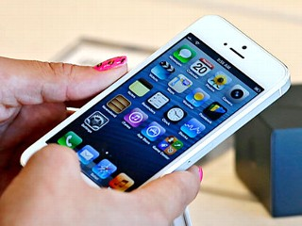
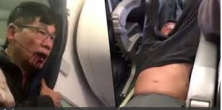
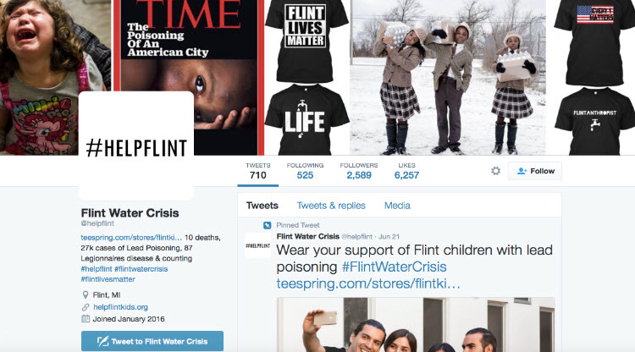

Speed
The speed with which the news is produced and shared has altered media relations.
Notes:
Web has compressed publication times.
Media outlets publish continuously.
Greater focus on breaking news.
News at our fingertips, wherever we go – we are tethered to our smart phones – good or bad.

Slide 19

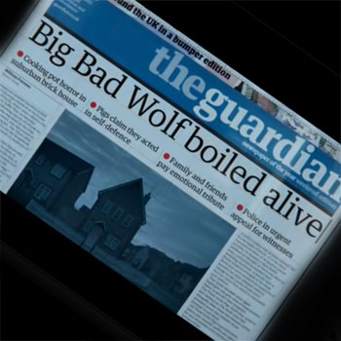
Who Are the Media?
News and the Web
Anyone can be a publisher or editor
Bloggers now have most of the power and brand control
Readers regularly publish comments
on journalists’ articles
Social media spread word-of-mouth
at broadband speeds
Twitter and Facebook allow instantaneous
broadcasting of comments
Who owns the story?
Notes:
. Previously news organizations “owned” the news story, but not today. Click on the image to run the 3 little pig video

Slide 20
Who Does What?
Let’s Talk Roles & Responsibilities

Slide 21

Media Channels
    With what media type can you best reach your target audience?
  Newspapers
  Wire Services/News Syndicates
  Magazines
  Radio
  Television
  Company Webpage
  E-mail
  VNRs
  Direct mailings
  Social media
Notes:
This is a listing of today’s media channels. They range from traditional newspapers to social media outlets.

Slide 22
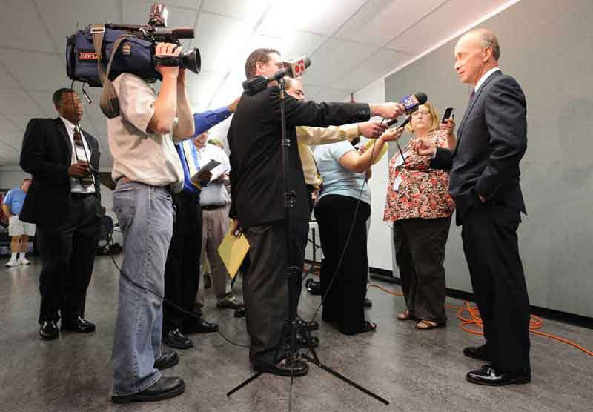
The Reporters Role
Generate reader interest
Tell all sides of the story, not just yours
Gather information from multiple sources:
customers, competitors, analysts
Obtain timely, useful information
Work under deadline pressure
Report on a variety of news, which may or
may not include your topic/industry or company
Notes:
Reporters must to tell the truth in an unbiased manner. Unlike PR professionals their job is to not only generate reader interest, but tell all sides of a story. PR professionals need only tell one side –that of our company.
Reporter’s today work under tremendous pressure so it is important that PR professionals respect the journalist/PR relationship.

Slide 23
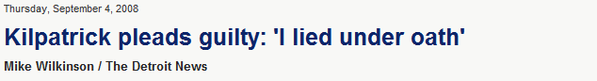
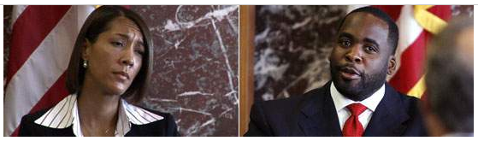
Your Role
Good media relations ensures accurate, balanced and timely release of your organization’s information
We are the middlemen – the connector
PR & media have adversarial relationship, which serves the public interest
Cutlip’s guidelines for good media relations:
  Be honest – never lie
  Give service
  Do not beg or complain
  Do not ask to pull stories
  Do not flood the media with news
Goal = establish trust and long-term relationships
Notes:
What is it that you do for me? At the end of the day, most PR people, firms are measured by volume and quality of media placements, or, in crisis work, lack of media coverage. That’s why media relations skills are essential to any PR practitioners job.
Give service=bend over backwards to help them meet their deadline with news photos, etc.
Don’t flood the media = one reporter per outlet, only real news, update media lists frequently

Slide 24
Your Role: Establish Credibility
Proactive Media Relations
Get as much information as possible prior to meeting
  Reporter’s interest/bias
  Reporter’s knowledge of the industry
  Media outlet and its audience
    Tailor message to audience and reporter
    Time message to publication and/or reporter deadlines
    Initiate contact
  Deadline
Establish Your Agenda
  Analyze your audience
  Identify your objectives
  Identify three key points
Notes:
Public relations professionals need to connect with reporters, build relationships, and establish that they are credible source that a reporter will want to come back to time and again.

Slide 25
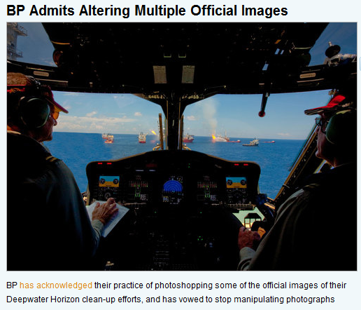

Your Role: Tell the Truth; Just the Facts
BP CEO Tony Hayward
“I think the environmental impact of this disaster is likely to have been very, very modest.”
“I’d like my life back.”
  Untruths: Don’t lie, the truth will out; and don’t withhold bad information, it will turn into a damaging, negative story.
  Don’t pick a fight: reporters are neither friends nor enemies; they are professional colleagues.
Notes:
Fatal Flaws:
Off the record: no such thing.
“No Comment”: makes it look like you have something to hide.
Off the cuff: you’re risking an outrageous verbal faux pas
Missing a deadline: the news cycle moves quickly; help the journalist meet deadlines.
Untruths: Don’t lie, the truth will out; and don’t withhold bad information, it will turn into a damaging, negative story.
Don’t pick a fight: reporters are neither friends nor enemies; they are professional colleagues.

Slide 26
Your Role: Seize the Opportunity
Get the interview you want!
Vaccines Gave my Grandson Autism
NY Times “oops!”
Rupert Murdoch
Anticipate the story the reporter may want, and come up with an effective message. Don’t just say, “…I don’t really want to talk about it ...”
Notes:
Take a moment to watch each video. Consider what you may have done differently. Think about how you can best represent your company in front of the camera.

Slide 27
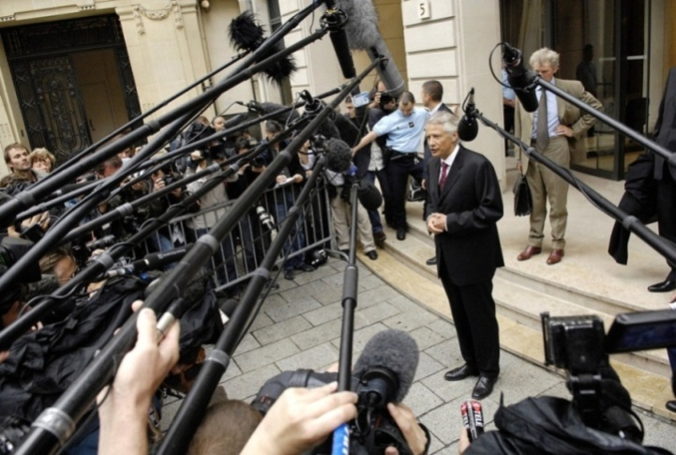
Best Practices
Media relationship best practices
  Keep the audience in mind when pitching the story
  Keep it simple – jargon free
    Use short, informative sentences
  Start with your most important message point
  Don’t argue with the reporter
  Don’t repeat false statements
  Don’t over-answer
  Focus on key messages/bridge back to main points
    “Well, what’s really interesting is … or… what’s really important…”
  Use facts at hand, not from memory
    It’s okay if you don’t know an answer, but get back to the reporter as soon as possible
    Say “I don’t know, but let me find out and I’ll get back to you” rather than winging it
  Be truthful
  Never give personal opinions (speak to issue, message and goals)
  Do not respond to hypotheticals, stick to facts
  Don’t only contact reporters when you want something
    Additional resources
      Offer reporters analysts and customers that will help them round-out their story
  Never go “off the record”
  Be gracious – say “Thank You!”

Slide 28
Works Cited
Seeger, M. W., Reynolds, B., & Sellnow, T. L. (2009). Crisis and emergency risk communication in health contexts: Applying the CDC Model to Pandemic Influenza. In Heath, R. L., & O’Hair, D. H. (Eds.), Handbook of risk and crisis communication (302-322). New York: Routledge Taylor and Francis Group.
Seeger, M. W. , Sellnow, T., & Ulmer, R. R. (2008) Crisis Communication and the pubic health. Hampton Press: Cresskill, NJ.
Seeger, M. W., (2006) Best practices in Crisis and Emergency Risk Communication. Journal of Applied Communication Research, 34, 3. Pp. 232-244.
Reynolds, B. & Seeger, M. W. (2005). Crisis and Emergency Risk Communication as an integrative model. Journal of Health Communication Research.
Seeger, M. W. , Sellnow, T. & Ulmer, R. R. (2003). Communication, organization and crisis. Preager
Seeger, M. W., Venette S. Ulmer, R. R. & Sellnow, T. (2002). Patterns of media use, information seeking, and reported needs in post-crisis contexts. In B. Greenberg, (Ed.). Communication and terrorism. pp. 53-63. Cresskill, NJ: Hampton Press.

