Slide 1
Brew Your Business
A CASE STUDY

Slide 2
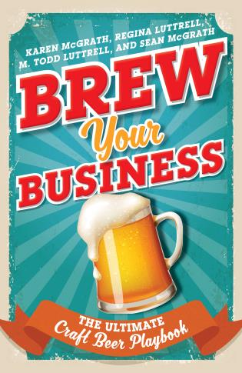
Brew Your Business case study
The authors of Brew Your Business: The Ultimate Craft Beer Playbook (http://www.brewyourbusiness.com/) set out to build an understanding of not only how to brew craft beer, but also how to focus on the business and science of this ever-growing industry.
To that end, once the book was set to publish, they worked with Joshua Schwartz, Principal of Pubvendo, a company that works specifically with publishing houses and authors to launch and promote books.

Slide 3
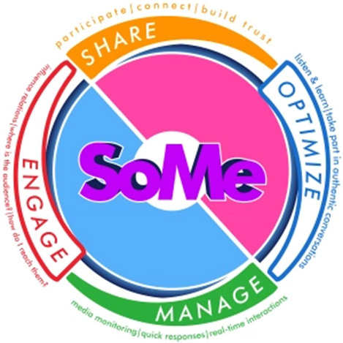
Brew your Business Case sTudy
The Circular Model for SoMe for Social Communication- Pre-planning Phase
Share | Optimize
Cross promote efforts on social media, specifically Facebook and Twitter, Amazon, and the books’ website. | Ensure book website, Amazon retail page, Amazon author pages, Goodreads book page, and Goodreads author pages populated and optimized for search.
Manage | Engage
Measurement conducted through platform specific analytic tools. | Engage with and respond to fans RT, conversing, and sharing; engage influencers such as American Brewers Association, Beer Pulse, Master Brewers, The Beer Goddess, & local craft breweries across the nation.

Slide 4
ROSTIR – Research/Diagnosis
Research & Diagnosis
  Secondary Research
  Audience:
    Caucasian, male, upper-middle class,
    Business professionals between the ages of 25-44 (94.6%)annual incomes between $30,000-$74,999 (80.0%)
    Exhibiting a strong affinity for beer, brewer brands, lifestyle brands and influencers including Anthony Bourdain, Patton Oswalt, and Jim Gaffigan.
    Audience persona/profile: “Beer Bros”

Slide 5
ROSTIR – RESEARCH/DIAGNOSIS
Competitive Analysis
  Pubvendo identified three similar author brands and three beer and brewing communities:
    Charlie Papazian. The founder and former president of the Brewers Association and author of numerous books on beer and craft brewing.
    Dick Cantwell. Currently the Brewers Association Quality Ambassador and author of several books on beer and craft brewing.
    John J. Palmer. The Director of Publications at the Master Brewers Association and author of several books on beer and craft brewing.
    American Homebrewers Association. Selected due to strong audience interest in home brewing news and information.
    Beer Pulse. Selected due to strong audience interest in beer.
    CraftBeer.com. Selected due to strong audience interest in craft beer.

Slide 6
ROSTIR – research/diagnosis
The research uncovered three key areas that would serve as the foundation of the promotion of the book:
Optimize the book’s Amazon retail presence to encourage Amazon to programmatically promote the book within the Amazon ecosystem.
Drive audience growth and engagement on Facebook and Twitter through beer release announcements wherein the probability of engagement from tagged breweries would be high, thus extending reach to followers of tagged breweries.
Work with local, regional, and trade publications within the food, beer, and wine industry for book reviews, interviews, and article mentions driving publicity and website traffic to the book website and Amazon retail page.

Slide 7
ROSTIR- Objectives
Drive click-through through social media advertisements to the Amazon retail page at or above 5.0% at a cost-per-click (CPC) rate close to $0.05 per click, resulting in conversion to book preorders and purchases.
1
Drive engagement of at least 5% with target audience, as measured by social and digital metrics.
2
Generate broad local, regional and national earned media coverage as a result of the launch of Brew Your Business between November 2017 until January 1, 2018.
3

Slide 8
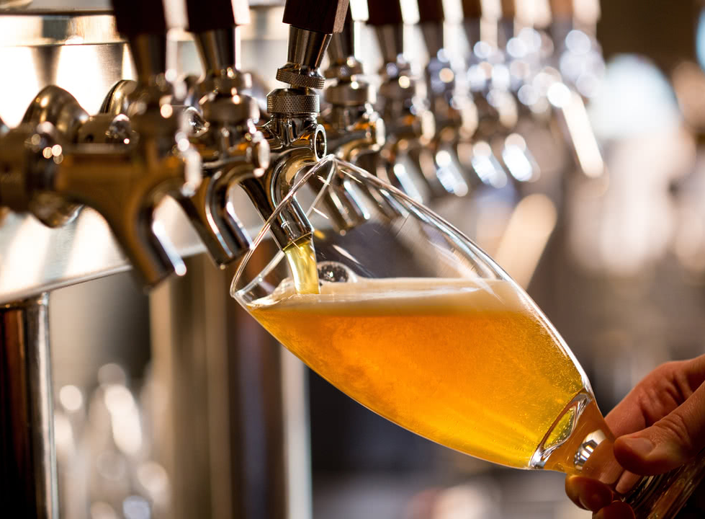
ROSTIR - strategies
The approach was simple: create content to disseminate across paid, earned, and owned media channels that is compelling to the book’s target audience.
Celebration of New Beer Releases/New Brewery Openings: Announcements for new beer releases and new brewery openings receive high engagement.
Tips on Brewing and Brewery Operations: When accompanied by a picture or video, tips on brewing and brewery operations (i.e. QC, Beer Systems Cleaning, etc.) receive high engagement.
Celebration of the History of Craft Brewing: Posts celebrating the history and of craft brewing (i.e. “There were 1,511 breweries in the United States in 2007. Today there are 5,562) receive high engagement.

Slide 9
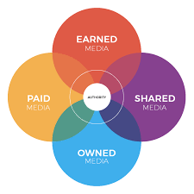
ROSTIR - Tactics
Paid:
  Launched a six-week paid social media campaign on Facebook and Twitter that both promoted the book, but also engaged the beer community.
Earned:
  Conducted proactive outreach to print and online editors within the craft beer, food, and wine industry.
Shared
  Built a Facebook and Twitter community consisting of consumers, craft beer enthusiasts and influences. Conversations within these communities included adding messaging about the book to existing conversations surrounding craft beer.
Owned:
  Implemented a search engine optimization initiative for the http://www.brewyourbusiness.com/ website.
  Applied an SEO keyword strategy for the website and Amazon
  Consistently used top hashtags to maximize reach on Facebook and Twitter: #homebrew #beer #craftbeer #brewing #cheers (hashtagify.me)
  Hosted book signing parties at local craft brewery locations and local book stores including Barnes & Noble.

Slide 10
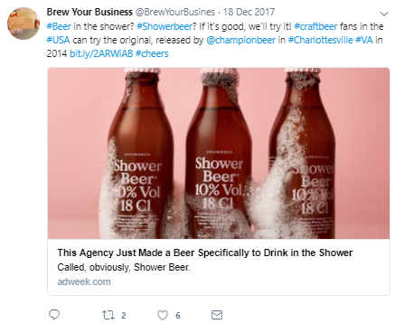
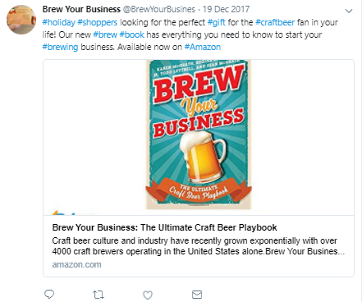
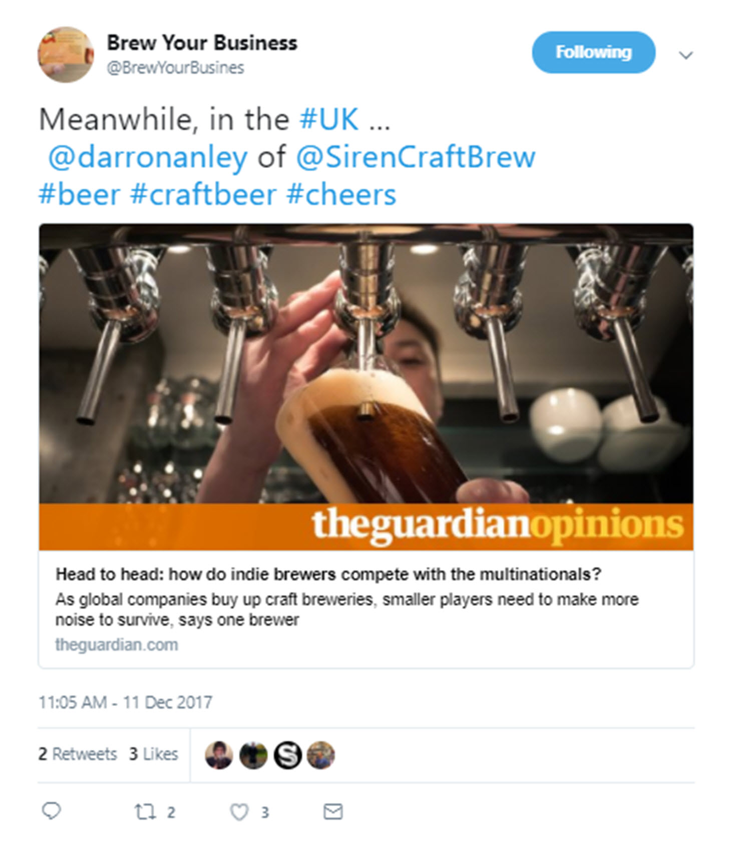
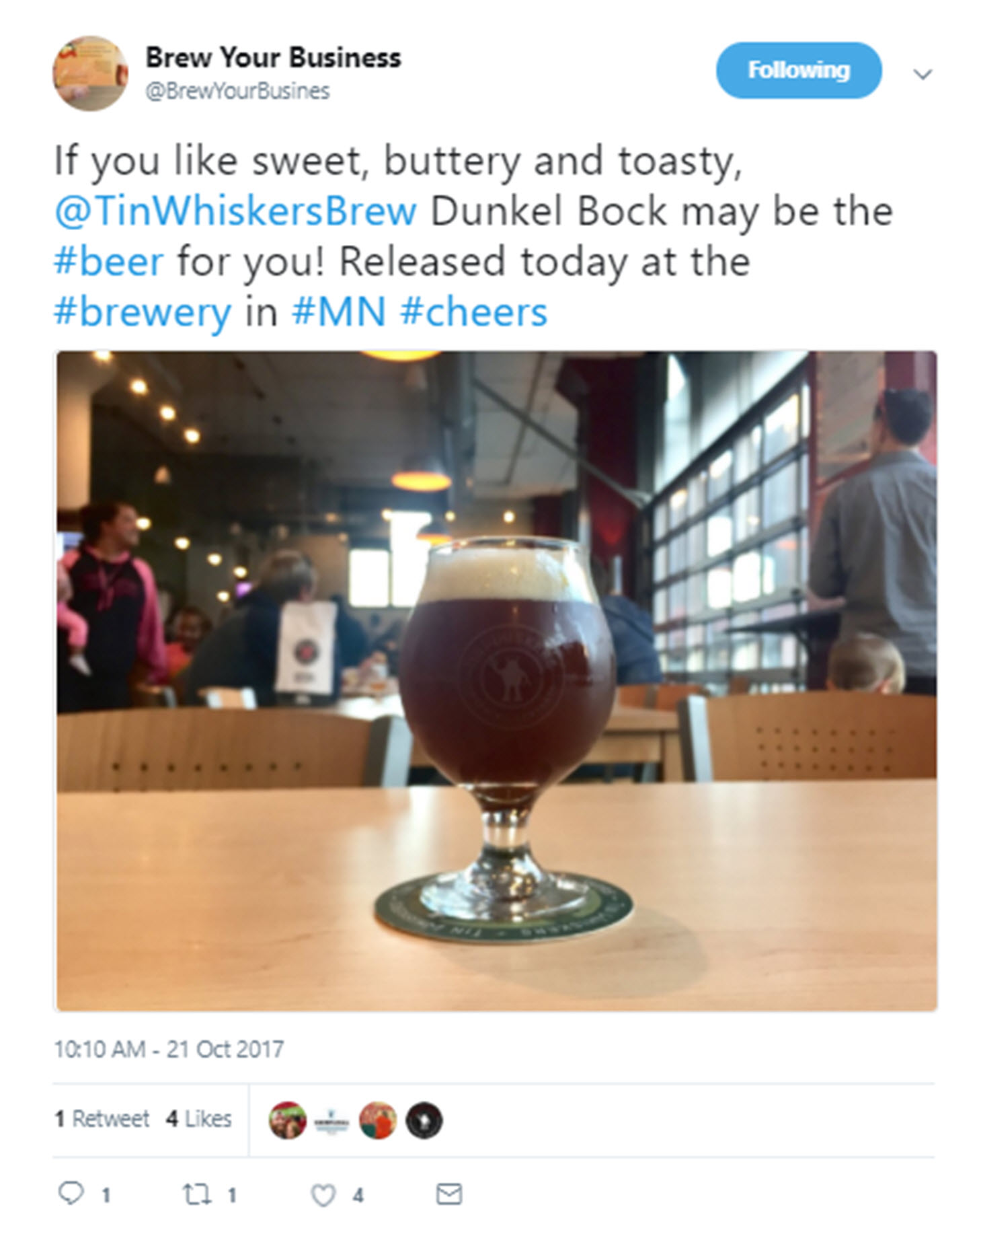
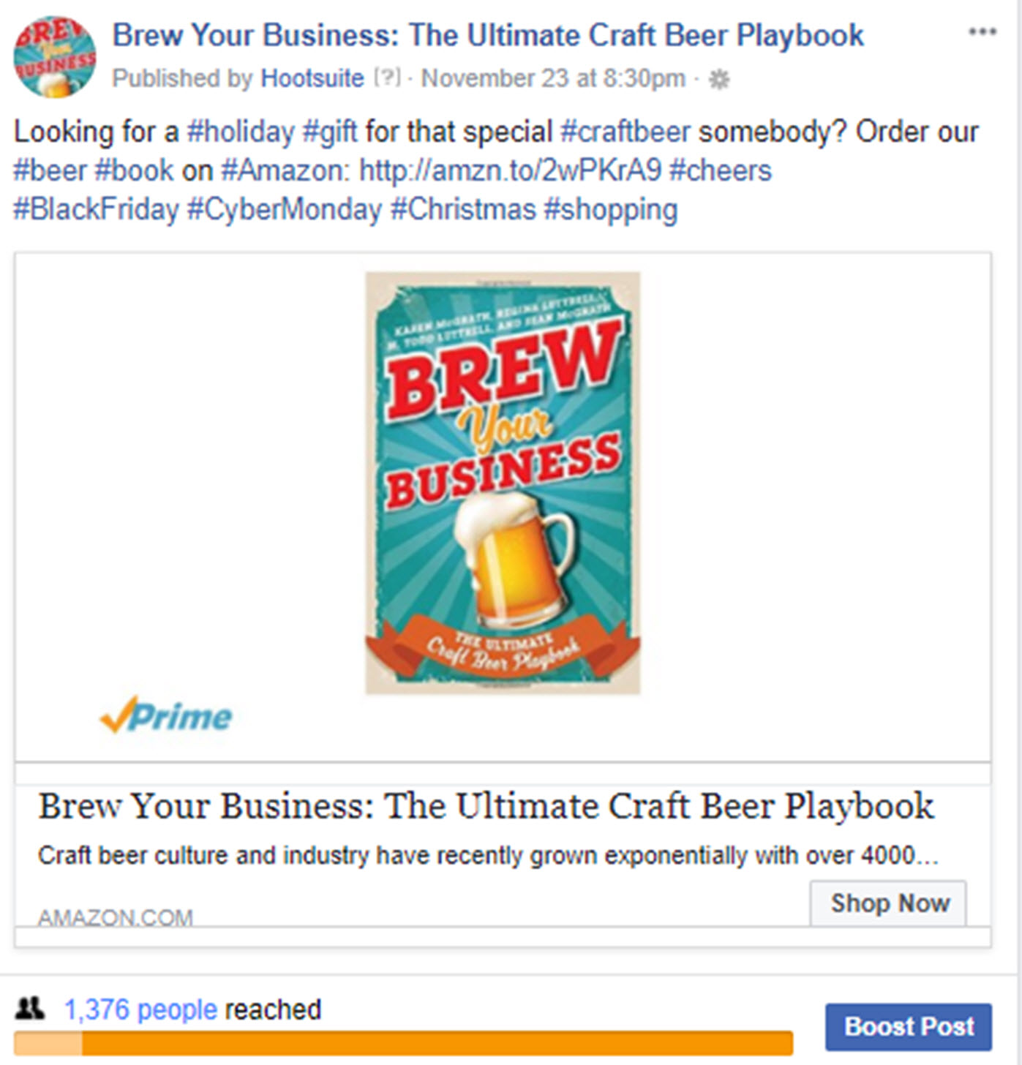
ROSTIR - implementation
12 weeks
$300

Slide 11
ROSTIR – reporting/evaluation
The launch and promotion of Brew Your Business exceeded all expectations.
  Upon publication and during Black Friday / Cyber Monday promotions, the book achieved a #1 Amazon bestseller ranking in the Business Entrepreneurship category.
  Positive conversation about the launch of the book on Twitter and Facebook; moved from net neutral to net positive conversation.
    In November and December 2017, achieved 39.6k Twitter impressions compared to 3k Twitter impressions in September and October 2017, primarily through engagement from tagged influencers and paid social ad promotions.
    Achieved social ad click-through rates between 5.0%-6.5%
  The campaign achieved 16 placements collectively receiving more than 2.9 million monthly website visits (based on estimated November 2017 website visits).
  Garnered 17 media interviews (and still counting)
  Sold more than half of the initial print run of the book

